Slide 1
Understanding IP Addresses in System Design
Networking & Communication

Slide 2
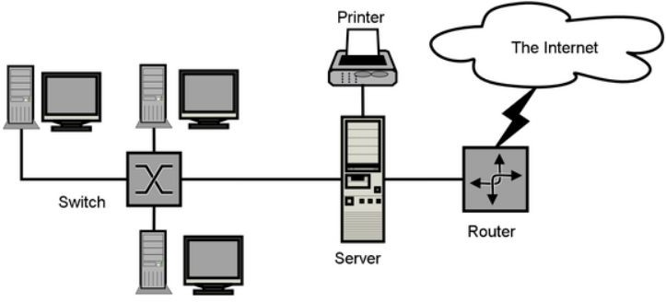
Introduction to IP Addresses
IP (Internet Protocol) addresses are unique numerical labels assigned to devices on a network.
They enable communication between diﬀerent machines, servers, and services across the internet.
Two primary versions:
  IPv4
  IPv6
Two primary categories:
  Public
  Private

Slide 3

What is IPv4?
IPv4 (Internet Protocol Version 4) is the most widely used addressing system.
32-bit address format (e.g., 192.168.1.1)
Total addresses available: ~4.3 billion
Uses: Traditional networking, web servers, and most current internet devices.
Challenges: Limited IPs, fragmentation, and security concerns.

Slide 4
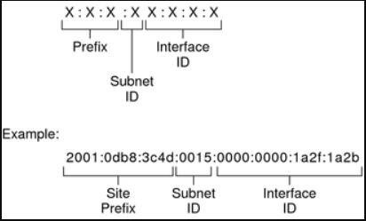
What is IPv6?
IPv6 (Internet Protocol Version 6) is the next-generation IP standard.
128-bit address format -
2001:0db8:85a3:0000:0000:8a2e:0370:7334
Total addresses available: 340 undecillion (virtually unlimited).
Designed for: IoT, mobile networks, and
future scalability.
Key beneﬁts: Larger address space, better security, and improved routing eﬃciency.

Slide 5
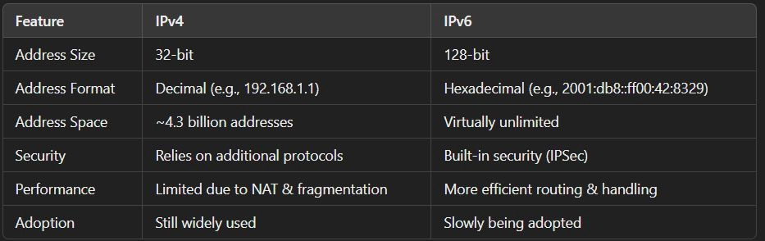
IPv4 vs. IPv6 – Key Differences

Slide 6
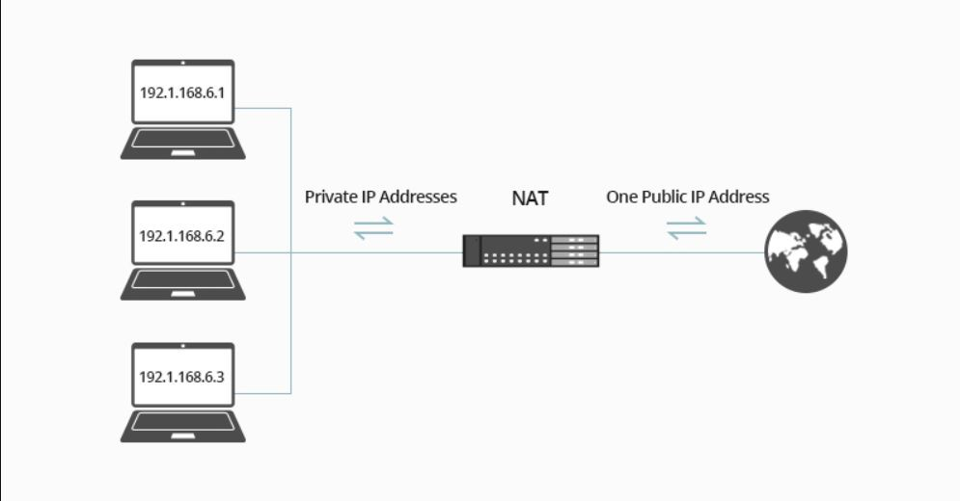
Private vs. Public IPs
Public IPs:
  Assigned by ISPs (Internet Service Providers).
  Used to communicate over the internet.
  Unique worldwide.
  Example: 192.203.23.45.
Private IPs:
  Used within local networks (LANs, enterprises, homes).
  Cannot be accessed directly from the
internet.
  examples:
    10.0.0.0 - 10.255.255.255
    172.16.0.0 - 172.31.255.255
    192.168.0.0 - 192.168.255.255

Slide 7
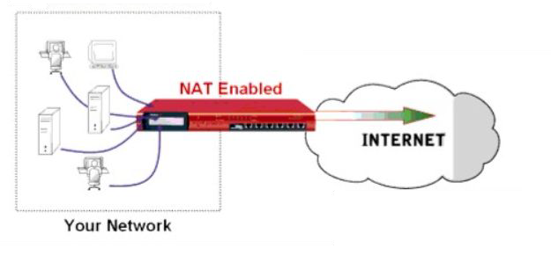
Why Do We Need Private IPs?
Conserves public IP addresses (IPv4 limitation).
Enhances security (private IPs are not routable over the internet).
Enables Network Address Translation (NAT) to allow multiple devices to share a single public IP.
Common in corporate networks, data centers, and cloud environments.

Slide 8
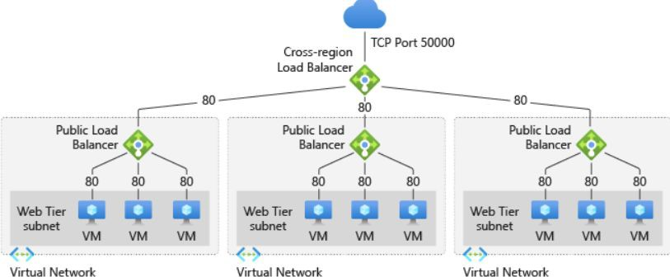
The Role of IPs in System Design
Scalability: Helps in designing distributed, multi-region, and cloud-based architectures.
Security: Enables ﬁrewall rules, VPNs, and private networking.
Load Balancing: Uses IP-based traﬃc distribution (e.g., Round-robin DNS, Anycast IPs).
Cloud Networking: Public, private, and hybrid cloud IP management (AWS, GCP, Azure).
Microservices & Containers: Use internal private IPs for communication.

Slide 9
Common System Design Interview Questions on IPs
How do IPv4 and IPv6 addresses diﬀer?
Why do we need private IPs in system design?
How does NAT help in addressing the IPv4 shortage?
Explain how a load balancer distributes traﬃc using IPs.
How does DNS resolve IP addresses in a large-scale system?

Slide 10
Summary & What’s Next
IPv4 and IPv6 are the two primary internet protocols.
Private vs. Public IPs help manage internal and external networking.
Networking & IPs are essential for system scalability, security, and performance.
Coming up next: How DNS works and its role in system design.

